Slide 1
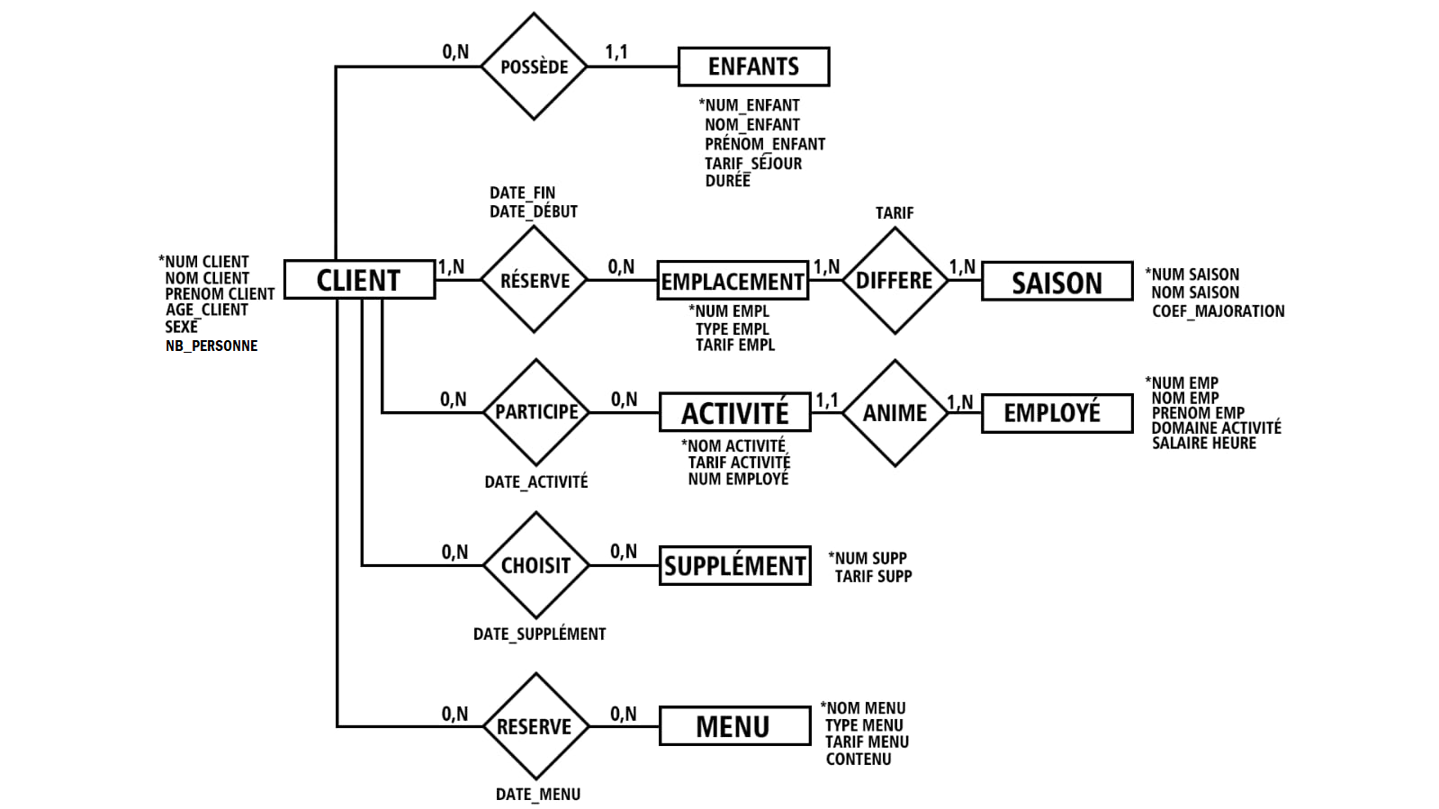

Slide 2
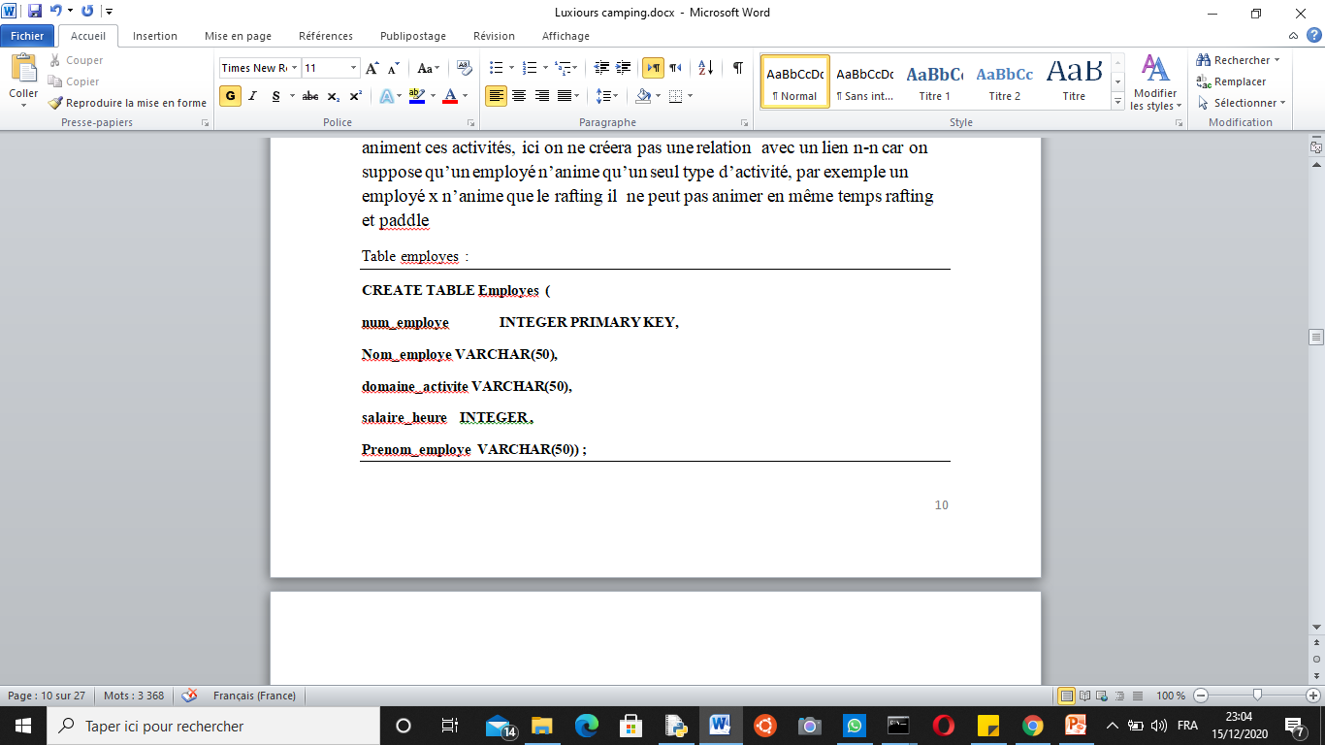
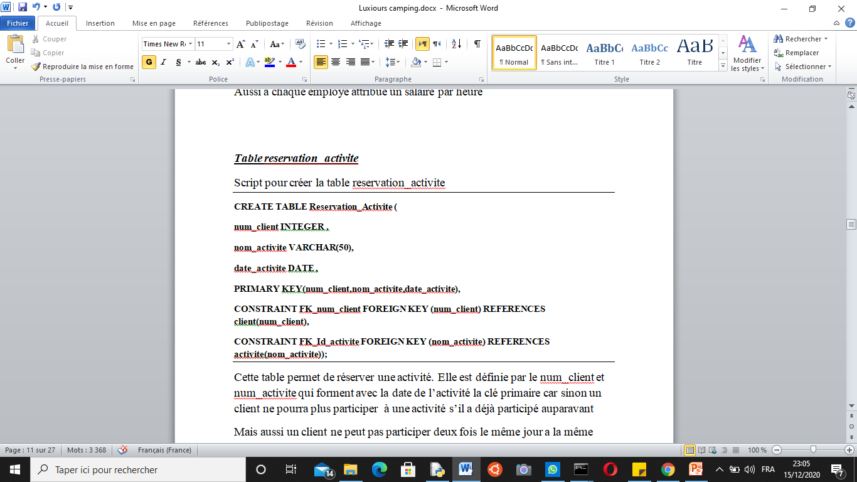
CREATE TABLE client (
num_client INTEGER PRIMARY KEY,
Nom VARCHAR(50),
sexe dom_sexe ,
age dom_age ,
nb_personne dom_nb_personne ;
Prenom VARCHAR(50) ) ;
--------------------------------------------------------------------------------------------------------------------------------------------------
CREATE TABLE enfant (
num_enfant INTEGER PRIMARY KEY,
Nom_enfant VARCHAR(50),
Prenom_enfant VARCHAR(50),
sexe dom_sexe ,
age dom_age_enfant,
duree_sejour_enfant INTEGER ,
tarif_sejour_enfant INTEGER ,
num_client INTEGER ,
CONSTRAINT fk_num_client FOREIGN KEY
(num_client)REFERENCES client(num_client));
-------------------------------------------------------------------------------------------------------------------------------------------------
CREATE TABLE Activite (
Nom_activite VARCHAR(50) PRIMARY KEY ,
tarif_activite integer ,
CONSTRAINT fk_num_employes FOREIGN KEY (num_employe) REFERENCES employes(num_employe)) ;

Slide 3
